Slide 1
C++ array
Kusal Bista

Slide 2
C++ Arrays
C++ provides a data structure, the array, which stores a fixed-size sequential collection of elements of the same type.
An array is used to store a collection of data, but it is often more useful to think of an array as a collection of variables of the same type.

Slide 3
Declaring Arrays
type arrayName [ arraySize ];
This is called a single-dimension array. The arraySize must be an integer constant greater than zero and type can be any valid C++ data type.
For example, to declare a 10-element array called balance of type int , use this statement −
int balance[10];

Slide 4
Initializing Arrays
int balance[5] = {1,2,3,4,5};
Accessing array:
balance [index]

Slide 5
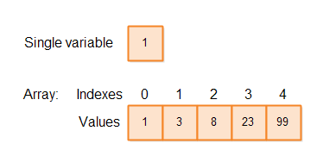
Index

